Slide 1
Embedded Systems
Topic : Analog Electronic components ,serial and parallel transmission

Slide 2
Basic Analog Electronic Components are:
Resistors
Capacitors
Inductors
Diodes
Transistors etc.,

Slide 3
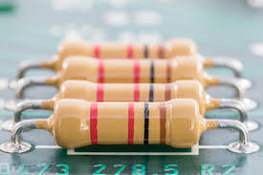
Resistors
A passive electrical component with two terminals that are used for limiting the flow of electric current in electrical circuits.
It is made of copper wires which is coiled around a ceramic rod and the outer part of the resistor is coated with an insulating paint.

Slide 4
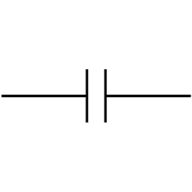
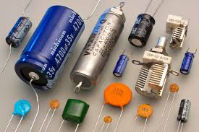
Capacitors
A capacitor is a two-terminal electrical device that possesses the ability to store energy in the form of an electric charge.
Capacitors are mainly used in signal filtering and Resonating circuits
Symbo1:

Slide 5
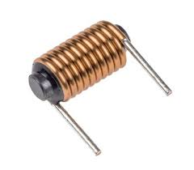
Inductors
An inductor is a passive component that is used in most power electronic circuits to store energy in the form of magnetic energy when electricity is applied to it.
Inductors are coil-like structures that are found in electronic circuits

Slide 6
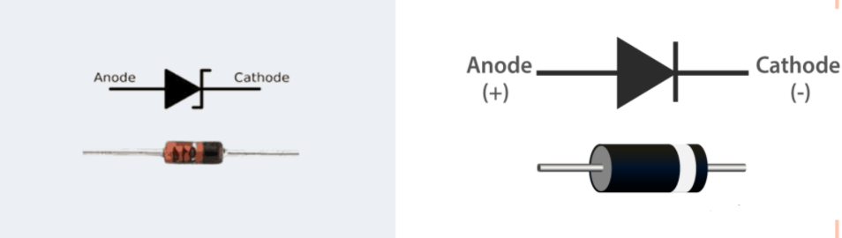
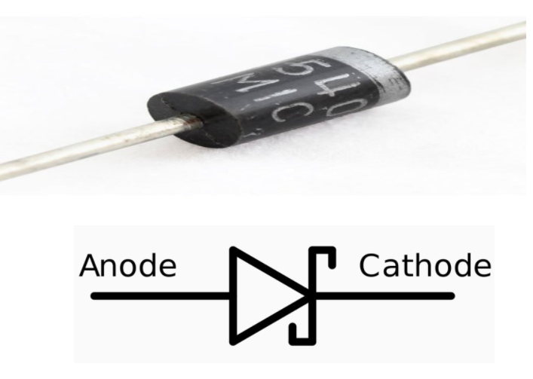



Diodes
It is an electrical component that allows the flow of current in only one direction.
A P – N junction diode, schottky diode and zener diode are commonly used for embedded hardware components.

Slide 7
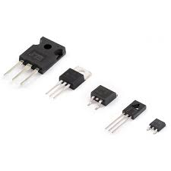
Transistors
A transistor is a semiconductor device used to amplify or switch electronic signals and electrical power.
Transistors are one of the basic building blocks of modern electronics
Ex: Relay, Buzzers etc.

Slide 8
Serial and parallel Transmission
Data Transmission:
Data transmission is a means of transmitting digital or analog data over a communication medium to one or more devices.
Data transmission can either be analog or digital.

Slide 9
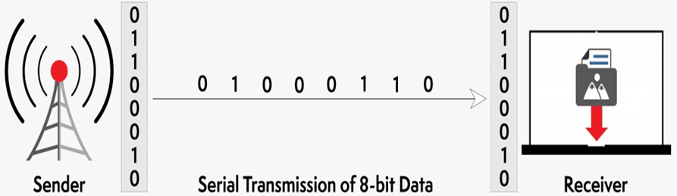
Serial Transmission
When data is sent or received using serial data transmission, the data bits are organized in a specific order, since they can only be sent one after another.
In this we have
1. Synchronous transmission
2. Asynchronous transmission

Slide 10
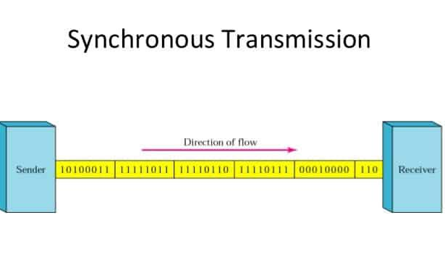
Synchronous:
Synchronous transmission does not use start and stop bits.
There is no gap between the various bytes in the data stream.
In the absence of start &amp; stop bits,
synchronization is established between
sender & receiver by ‘timing’ the
transmission of each bit.

Slide 11
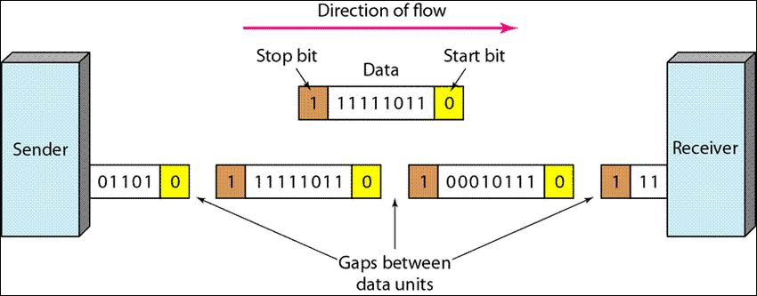
Asynchronous
Asynchronous transmission sends only one character at a time where a character is either a letter of the alphabet or number or control character i.e. it sends one byte of data at a time.
Bit synchronization between two devices is made possible using start bit and stop

Slide 12
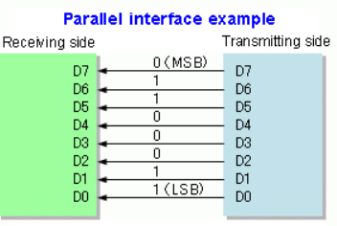
Parallel Transmission
In data transmission, parallel communication is a method of conveying multiple binary digits (bits) simultaneously. It contrasts with serial communication, which conveys only a single bit at a time,In parallel communication can convey 8 bits at a time.

Slide 13
When is parallel transmission used to send data?
A large amount of data is being sent
The data being sent is time-sensitive, and the data needs to be sent quickly. A scenario where parallel transmission is used to send data is video streaming. When a video is streamed to a viewer, bits need to be received quickly to prevent a video pausing or buffering
.EXAMPLE :An example of parallel mode transmission is a connection established between a computer and a printer. Most printers are within 6 meters (about 20 feet) from the transmitting computer.

Slide 14
Advantages:
1.It is easier to program;
2.Data is sent faster.
Disadvantages:
when we want to send N-bits of data then we require N-wires which makes it more complex.

Slide 15
Differences between parallel and serial transmission
SNO | Parallel Transmission | Serial Transmission
1 | This type of transmission permits the transmission of a n group of bits simultaneously. | In this transmission, all the bits are transmitted one after another.
2 | Separate lines are used for transmitting each group | Just one line is used for transmission
3 | This transmission is suitable for short distance. | This transmission is suitable for long distances.
4 | This transmission is expensive | It is cheaper in comparison

Slide 16
Thank you
Presented by:
K.Keerthi Priya- 18B01A1261
K.Divya sri- 18B01A1262
M.Bhagya Raja sree-18B01A1267

